Slide 1
Decred On-Chain Indicators
Format for indicator presentation:
Chart / Indicator Name
Calculation for Indicator

Slide 2
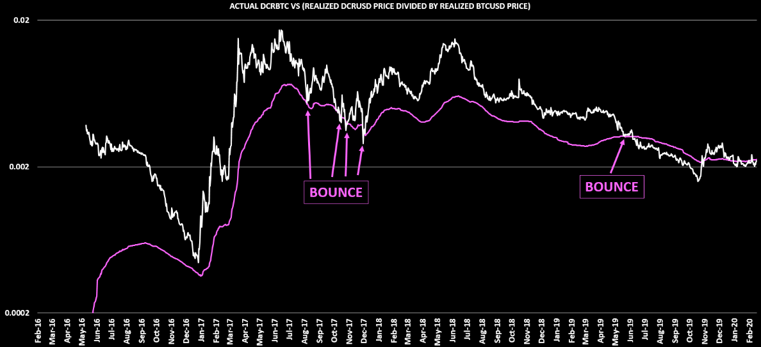
1: ON-CHAIN DCRBTC PRICE

Slide 3
1: ON-CHAIN DCRBTC PRICE
CALCULATION:
DCRUSD REALIZED PRICE
BTCUSD REALIZED PRICE

Slide 4
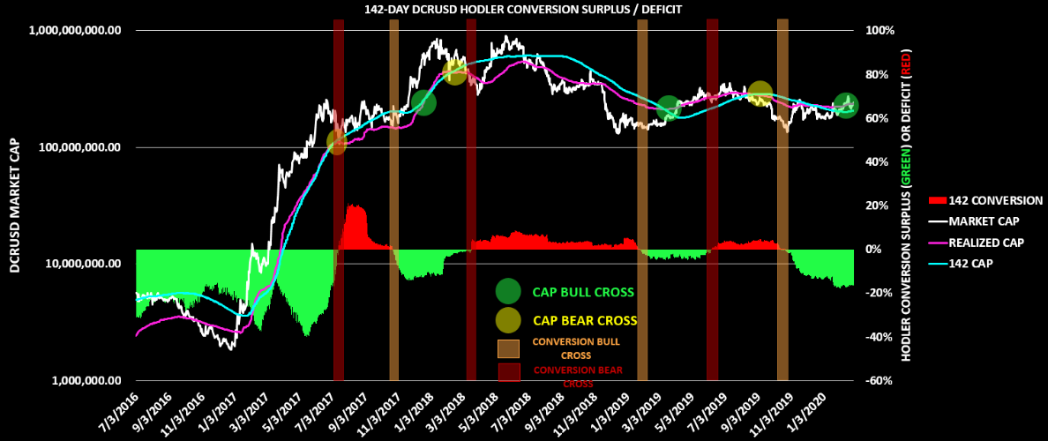
2: 142 DAY HODLER CONVERSION RATE

Slide 5
2: 142 DAY HODLER CONVERSION RATE
CALCULATION:
NOTE: “TOTAL SUM OF DCR MOVED OVER 142 DAYS” ON COINMETRICS = TxTfrValNtv

Slide 6
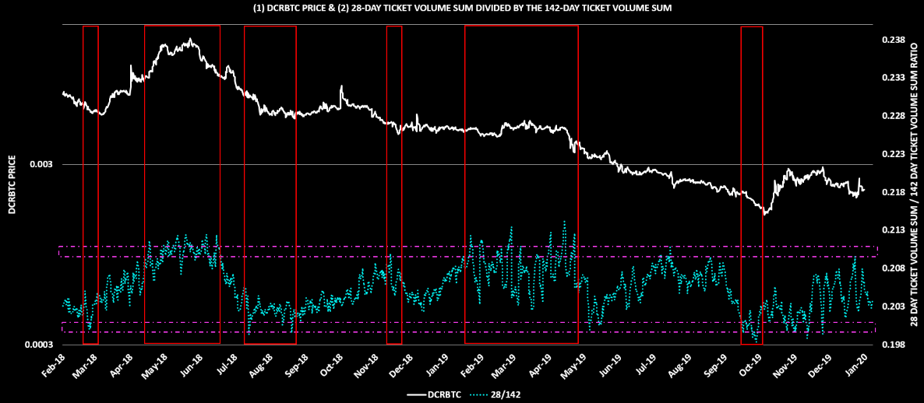
3: OVER / UNDER BOUGHT TICKET MEASURE

Slide 7
3: OVER / UNDER BOUGHT TICKET MEASURE
CALCULATION:
DCR SUM IN TICKETS OVER 28 DAYS
DCR SUM IN TICKETS OVER 142 DAYS

Slide 8
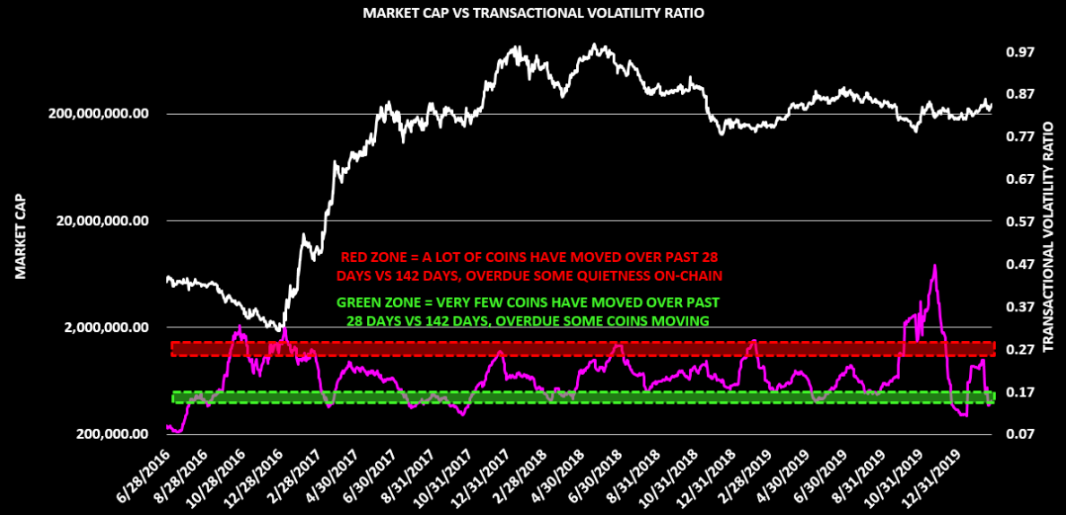
4: TRANSACTIONAL VOLATILITY RATIO

Slide 9
4: TRANSACTIONAL VOLATILITY RATIO
CALCULATION:
SUM OF DCR MOVED IN STANDARD TXS OVER 28 DAYS
SUM OF DCR MOVED IN STANDARD TXS OVER 142 DAYS
NOTE: “SUM OF DCR MOVED” ON COINMETRICS = TxTfrValAdjNtv

Slide 10
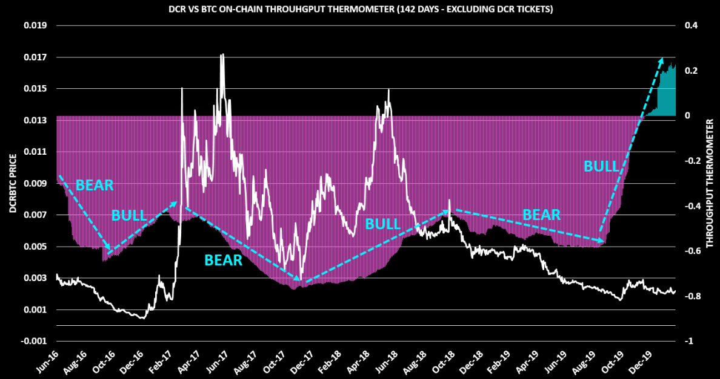
5: ON-CHAIN THROUGHPUT THERMOMETER

Slide 11
5: ON-CHAIN THROUGHPUT THERMOMETER
CALCULATION:
NOTE: COINS MOVED ON COINMETRICS = TxTfrValAdjNtv

Slide 12
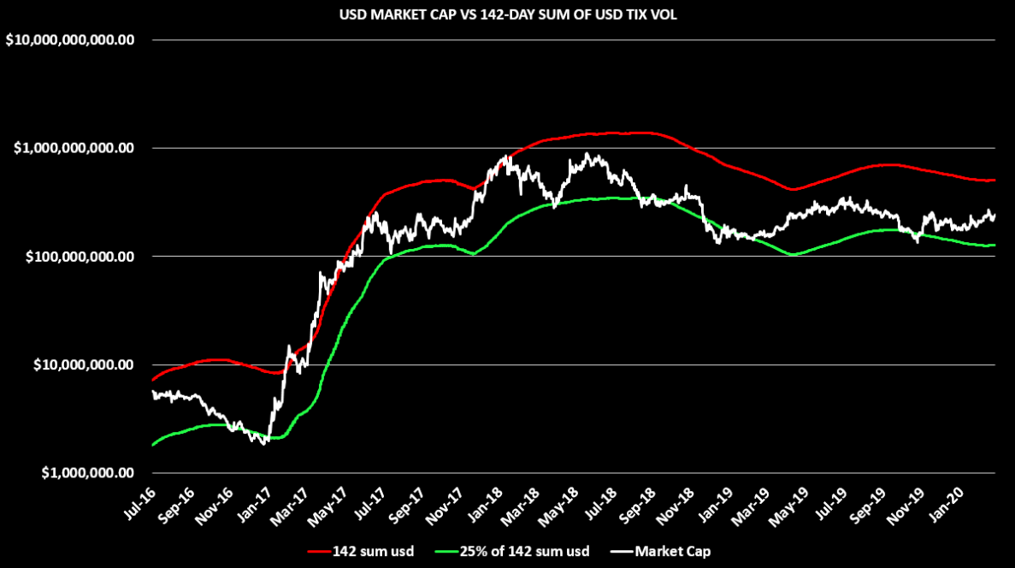
6: 142-DAY TIX VOL SUM

Slide 13
6: 142-DAY TIX VOL SUM
CALCULATION:
RED LINE = 142-DAY SUM OF USD VALUE TICKET VOLUME
GREEN LINE = 25% OF RED LINE

Slide 14
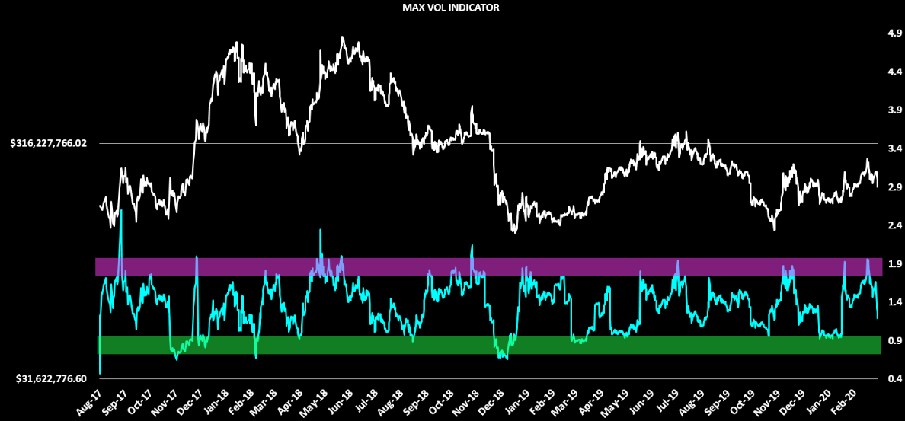
7: MAX VOL RATIO

Slide 15
7: MAX VOL RATIO
CALCULATION:
MARKET CAP
(MAX 288 BLOCK USD SUM IN TIX OVER PAST 28 DAYS) * 28

